Slide 1

Final Project Case Study in Face Recognition: Identification of Celebrity faces
Anand Krishnamoorthy
CSCI S-89 Introduction to Deep Learning
Summer 2020
Harvard Summer School

Slide 2
Table of Contents
Goal
Hardware and Software
Dataset
Introduction:
Flow chart
Results
YouTube link
Transfer Learning
Face Detection
Image Augmentation
Model Performance
Harvard Summer School

Slide 3
Goal
To build a model that learns the facial features of images to recognize celebrity faces.
The model suggests top 3 celebrity matches based on features extracted from the input image.
Other applications:
Which popular celebrity do you resemble?
Harvard Summer School

Slide 4
Hardware and Software
Hardware:
Google Colab: GPU Backend: Tesla p100.
Software:
Python 3
Keras – 2.3
Tensorflow – 2.2
MTCNN
Harvard Summer School

Slide 5
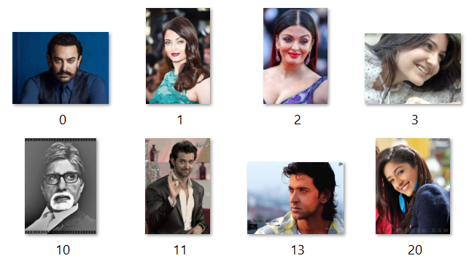
Dataset
Publicly available dataset in Kaggle
33 different Bollywood Celebrities (80-120 images for each celebrity)
Sample images used during training
Harvard Summer School

Slide 6
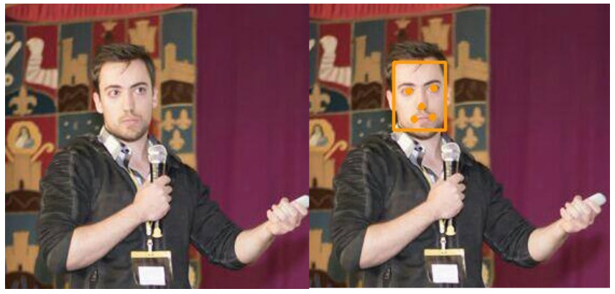
Face Detection: Introduction
Detect human faces in an Image.
MTCNN is a python library used for Face Detection.
Extracts key points like nose, mouth-right, mouth-left, right-eye and left eye.
Creates a bounding box around the face.
MTCNN example from the Package developer
Harvard Summer School

Slide 7
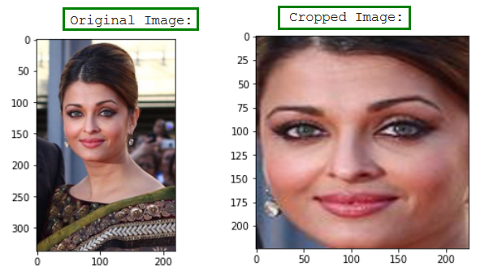
Introduction : Face Detection
For the ‘Identification of Celebrity faces’ project, MTCNN was used to crop faces from an image.
Example:-
MTCNN to crop faces
Harvard Summer School

Slide 8
Introduction : Transfer Learning
When you do not have enough training data, use lower layers of a pretrained model.
Initial layers capture high level features.
Fine tune lower layers – modify neural network weights to capture features relevant to your problem.
VGG Face – Model built to classify 2622 faces.
Freeze weights of initial layers.
Fine tune weights of layers near the output using new input.
Harvard Summer School

Slide 9
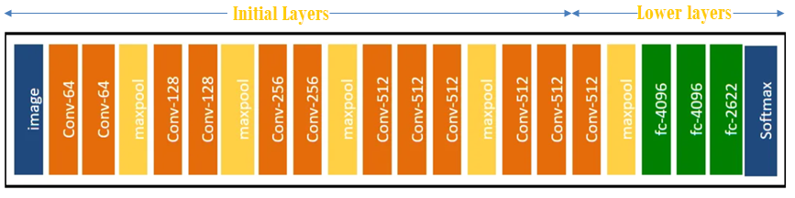
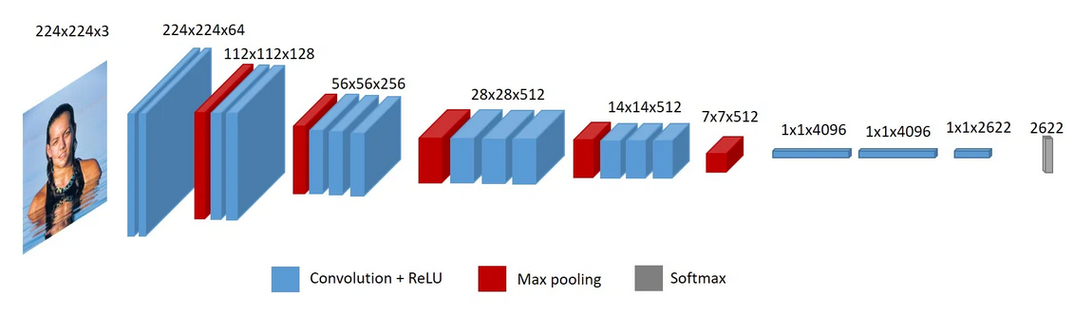
Introduction : Transfer Learning
Visualization of VGG face. Original article
Harvard Summer School

Slide 10
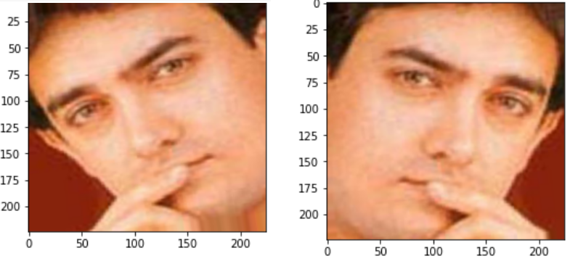
Introduction : Image Augmentation
Image Augmentation increases the size of the training set.
Reduces model overfitting
Example: Flipping images, rotating and zooming images.
Image Augmentation
Harvard Summer School

Slide 11
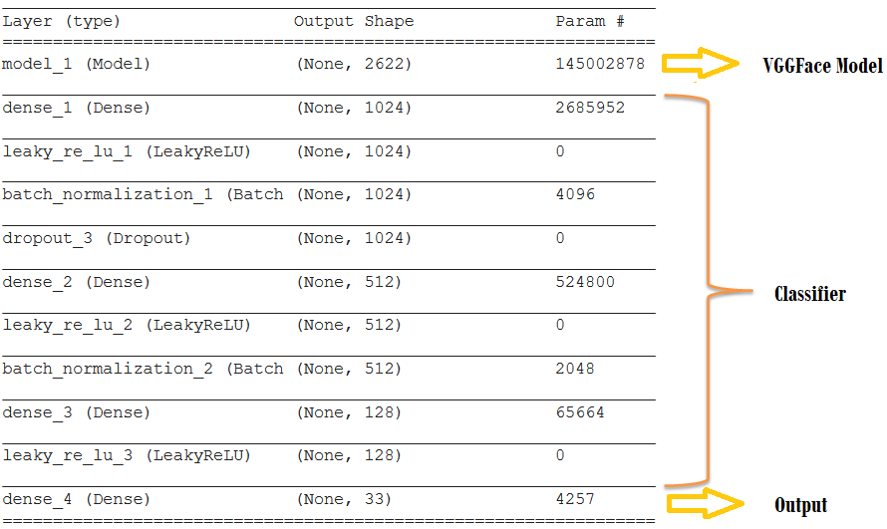
Flow chart
Crop Faces - MTCNN
Augment Images
Fine tune VGG Face
Build Classifier on top
Save Model
Phase 1 - Training
Phase 2 – Identify Celebrity
New Image
Crop Face
Identify closest celebrity
Harvard Summer School

Slide 12
Model Performance
Model Performed best with Fine Tuning last 8 layers of VGGFace with Cropped images and using Data Augmentation.
Fully connected NN added on top of VGGFace.
Model performed much better compared to few implementation posted online.
Accuracy achieved is lesser compared to the original VGGFace implementation.
Harvard Summer School

Slide 13
Model Performance
Pros
Good model Performance.
Works with relatively fewer dataset.
Cons
Model slightly overfitting.
Accuracy lesser compared to original VGGFace implementation.
Data Augmentation and Cropping face improves accuracy.
Harvard Summer School

Slide 14
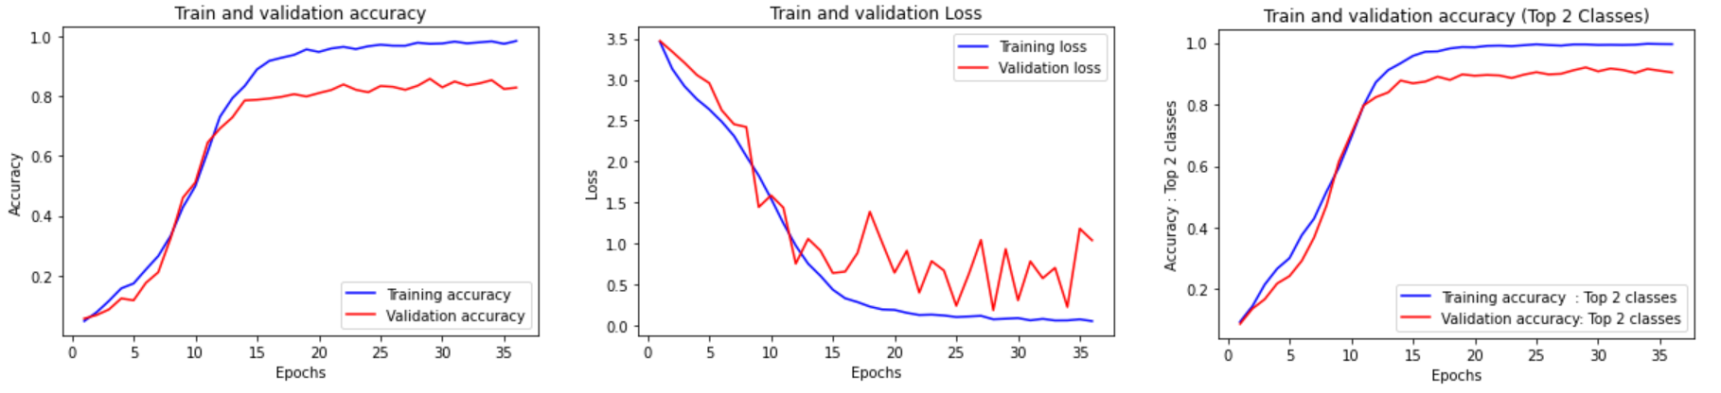
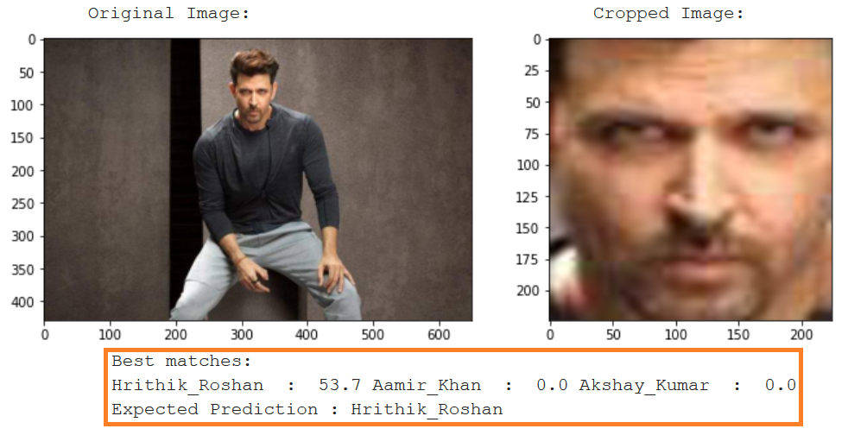
Results
Exact class: 86% accuracy
Top 2 class : 93% accuracy
Harvard Summer School

Slide 15
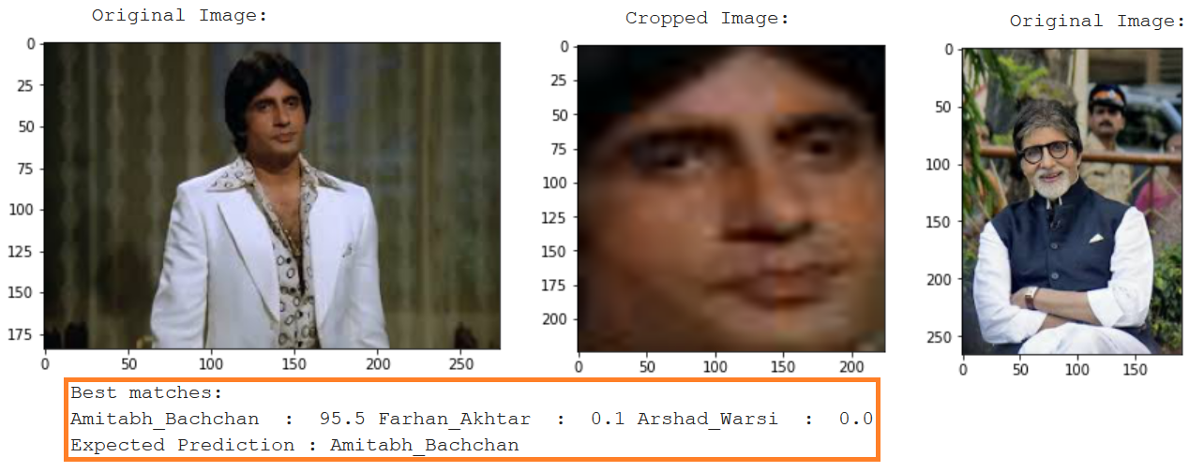
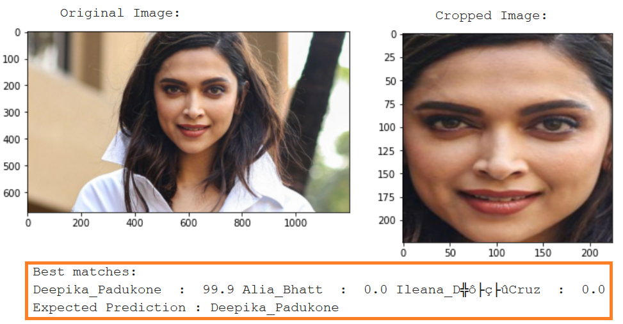
Results
Slightly Tolerant to age?
Harvard Summer School

Slide 16
YouTube Video Presentation
YouTube video presentation:
https://youtu.be/zggEJCC5C-8
References:
https://gist.github.com/EncodeTS/6bbe8cb8bebad7a672f0d872561782d9
https://drive.google.com/file/d/0B4ChsjFJvew3NkF0dTc1OGxsOFU/view
https://machinelearningmastery.com/how-to-perform-face-recognition-with-vggface2-convolutional-neural-network-in-keras/
https://medium.com/analytics-vidhya/face-recognition-with-vgg-face-in-keras-96e6bc1951d5

